Slide 1
CS 4350: Fundamentals of Software Engineering CS 5500: Foundations of Software Engineering Lesson 5.3 Evaluating Tests
Jon Bell, John Boyland, Mitch Wand
Khoury College of Computer Sciences
© 2021 Jonathan Bell, John Boyland and Mitch Wand. Released under the CC BY-SA license

Slide 2


Testing Evaluates Software Systems
Validation: Are we building the right product?
Verification: Are we building the product right?

Slide 3
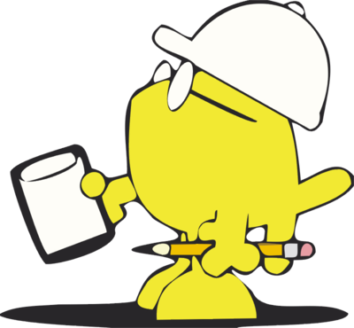
How Do We Evaluate Tests?
Purpose: Are tests checking the right things?
Adequacy: Are they checking the things right?

Slide 4
Learning Objectives for this Lesson
By the end of this lesson, you should be able to:
Describe measures of test suite adequacy, and to know their limitations;
Distinguish flaky and brittle tests;
Name several test smells, and give examples;
Explain some properties of good tests.

Slide 5
Review: Four Purposes of Tests
Acceptance Test
Customer-level requirement testing
Validation: Are we building the right system ?
Functional Test
“Black-Box” testing
Specification Testing
Structural Test
“White-Box” testing
Exercising the code
Regression Test
Prevent bugs from (re-)entering during maintenance.
These purposes are copied from Lesson 5.1

Slide 6

Adequacy of Acceptance Tests
Crucial: meet with prospective customers.
This is difficult, time-consuming and expensive.
But building the wrong product is much worse!

Slide 7

Supplement to Acceptance Evaluation
Dogfooding (“Eat your own dogfood”)
Be your own customer.
Weaknesses:
Employees unrepresentative of customers
Whether someone can be compelled to use a product does not say whether they would purchase it.

Slide 8
Foreshadowing
In Lesson 6.1, we cover “User-Centered Design”
These techniques can help us generate and evaluate acceptance tests.
More later!

Slide 9
Functional Testing Adequacy
Functional Tests also known as “Black-Box” testing.
Testing without regard to the implementation.
Functional tests are proxies for a specification:
A precise definition of all behavior of a SUT (outputs, state mutation, other effects) in all situations (state and inputs)
A specification may be formal (mathematical), informal (natural language) or implicit (“I know it when I see it”).
Adequacy of test suite is probability that an implementation passing all the tests actually fulfils the specification.
Not coverage of the SUT space!
E.g.: If a test contradicts the specification, the suite including it has zero adequacy!

Slide 10
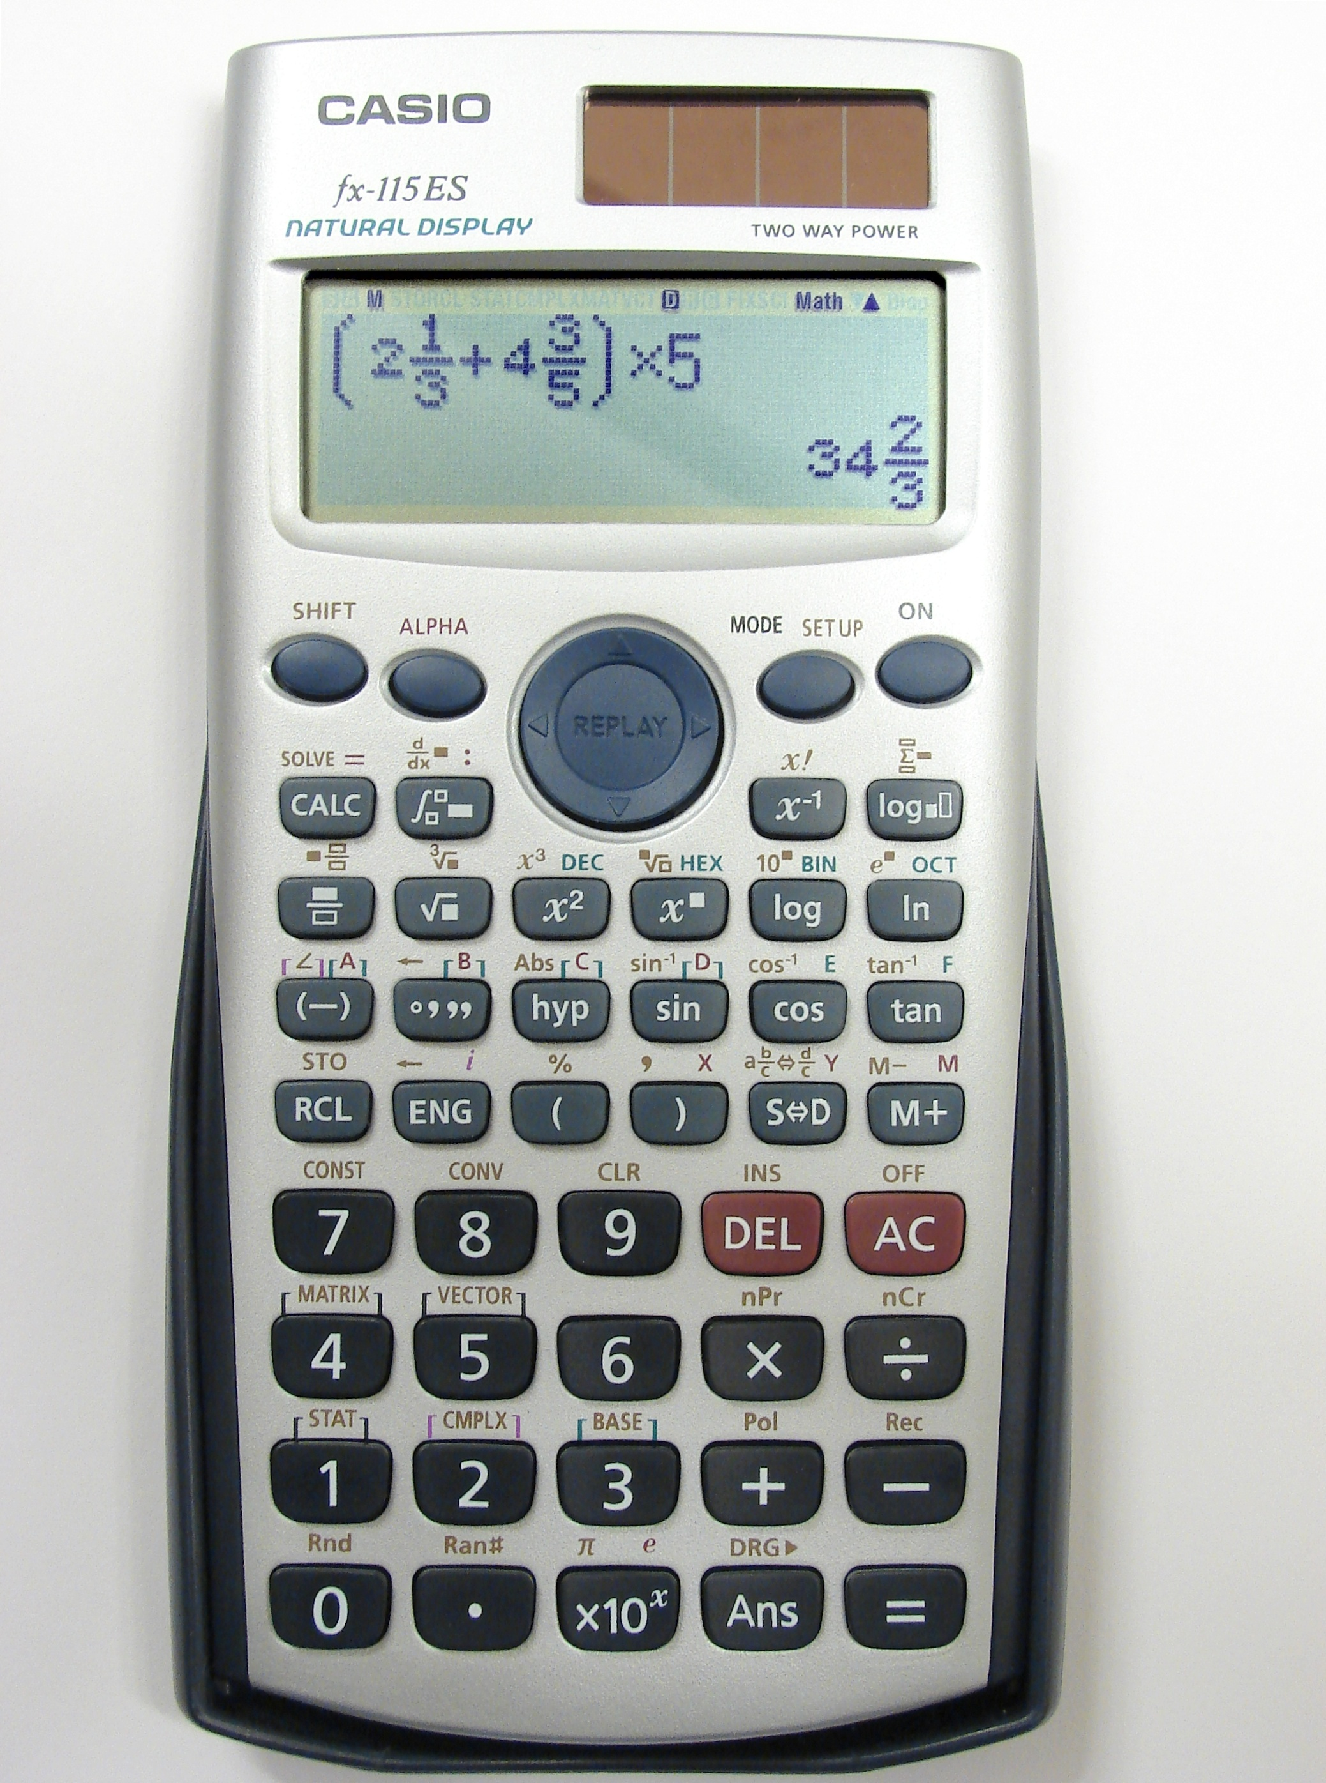
Coverage of Abstraction of SUT (1)
Find independently testable features (ITFs)
Test these separately;
Convert Cartesian product of possibilities to sum;
Danger: missed interaction

Slide 11

Coverage of Abstraction of SUT (2)
Select “special” values out of a range
Boundary values;
Barely legal, barely illegal inputs;
Ignore others;
Integer overflow a serious problem: may be implicit
ComAir problem due to a list getting more than 32767 elems
https://arstechnica.com/uncategorized/2004/12/4490-2/

Slide 12
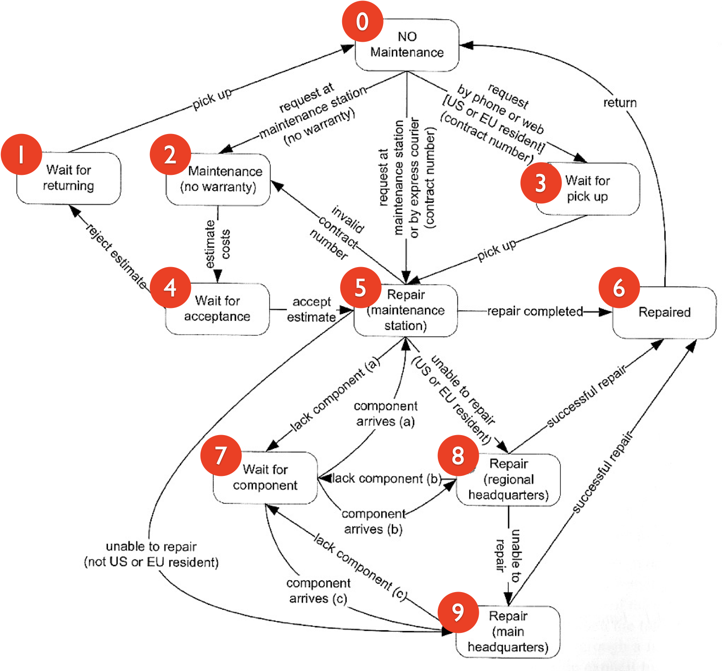
Coverage of Abstraction of SUT (3)
Abstract specification as a DFA
Then use Structural Testing over the abstraction.
Danger: system may be more complex than the model.
(from Pezze + Young, “Software Testing and Analysis”, Chapter 10)

Slide 13
Adequacy of Structural Testing
Structural Testing is also called “white-box testing.”
Purpose is to exercise code implementation.
Adequacy can be measured as %ge of goal:
Statement coverage
Branch coverage
Path coverage
Quantitative measurement is possible.

Slide 14
Structural Testing Example (1)
Break function into basic blocks
Build a Control-Flow Graph (CFG)
int cgi_decode(char *encoded, char *decoded) {
char *eptr = encoded;
char *dptr = decoded;
int ok = 0;
while (*eptr) /* loop to end of string (‘\0’ character) */
{
char c;
c = *eptr;
if (c == ’+’) { /* ‘+’ maps to blank */
*dptr = ’ ’;
} else if (c == ’%’) { /* ’%xx’ is hex for char xx */
int digit_high = Hex_Values[*(++eptr)];
int digit_low = Hex_Values[*(++eptr)];
if (digit_high == -1 || digit_low == -1)
ok = 1; /* Bad return code */
else
*dptr = 16 * digit_high + digit_low;
} else { /* All other characters map to themselves */
*dptr = *eptr;
}
++dptr; ++eptr;
}
*dptr = ‘\0’; /* Null terminator for string */
return ok;
}
A
B
C
E
D
G
I
H
F
L
M

Slide 15
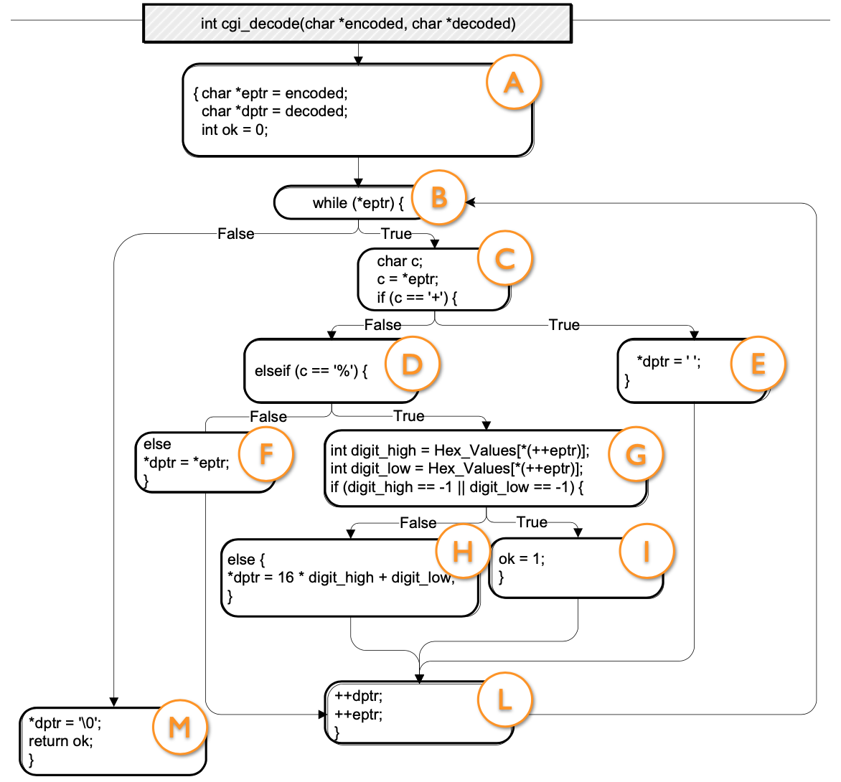
Structural Testing Example (2)
Evaluating Tests:
“test” (A,B,C,D,F,L,M)
“a+b” (A,B,C,D,E,F,L,M)
“%3d” (A,B,C,D,G,H,L,M)
“%g” (A,B,C,D,G,I,L,M)
Altogether, 100% block coverage
(first test could be omitted)
Also 100% branch coverage
If block “F” were absent, “%3d+%g” gets 100% block coverage while missing a branch.
(from Pezze + Young, “Software Testing and Analysis”, Chapter 12)

Slide 16
Structural Testing: Paths
Sometimes a fault is only manifest on a particular path
E.g., choosing the left branch and then choosing the right branch. (dashed blue path)
But the number of paths can be infinite
E.g., if there is a loop.
There are ways to bound the number of paths to cover.

Slide 17
Structural Test Criteria
Path coverage (usually impossible) implies
Repetition-Free Path Coverage implies
Branch Coverage implies
Block Coverage = Statement coverage.
(Other coverage criteria exist, some incomparable)
See https://en.wikipedia.org/wiki/White-box_testing

Slide 18
100% Coverage may be Impossible
Path coverage (even without loops)
Dependent conditions: if (x) A; B; if (x) C;
Edge coverage
E.g., if (x < 0) A; else if (x == 0) B; else if (x > 0) C;
Statement coverage
Dead code (e.g., defensive programming)

Slide 19
Mutation Testing
Mutation testing is a form of structural testing
The code in the SUT is mutated
E.g., replacing “&&” with “||” in an “if” statement.
Then we see if the test suite fails.
Mutation testing is more than coverage, because it checks that the change made a difference.
Difficult in practice:
Too many mutants possible (time)
Too many mutants are equivalent or uninteresting:
rpc.set_deadline(10); ⟶ rpc.set_deadline(20);
But possible!
https://research.google/pubs/pub46584/

Slide 20
Adequacy of Regression Tests (1)
Regression tests control maintenance:
A change cannot be committed until “all” tests pass.
Often “all tests” means “all small automated unit tests”
Adequacy includes whether tests cover all uses:
Uses may include unspecified behavior:
E.g., Users may assume that a hash result is non-negative;
Hyrum’s law: any visible behavior may have dependents.
Users are responsible to add tests:
Beyoncé rule: “If you liked it you should have put a ring test on it” (SoftEng @ Google)

Slide 21
Adequacy of Regression Tests (2)
Flaky tests are those that fail intermittently:
Nondeterminism (e.g., hash codes, random numbers);
Timing issues (e.g., threads, network).
Brittle tests are those that fail when tests changed:
Ordering (e.g., assume prior state)
Mystery tests aren’t clear why they fail:
How can the developer know what to do to fix?
All these impede maintenance:
A capricious, rigid or incomprehensible gatekeeper impedes the ability to make progress.
These definitions are not universal.

Slide 22
Adequacy of Regression Tests (3)
“Test Smells” name problem aspects of tests:
“Smell” = “Disagreeable Odor” (metaphor)
Can be seen when reviewing tests;
Named (as Design Patterns) for communication.
Two lists of ”Test Smells”:
van Deursen et al. Refactoring test code
https://www.peruma.me/project/test-smells/
Smelly tests more likely to be flaky, brittle, mysterious or otherwise “bad.”
Some examples on next slides.

Slide 23
Test Smells (1)
it(‘writes right’, () => {
const w =
fs.createWriteStream(‘test.txt’);
const t = createBigTree();
t.write(w);
w.end();
const d =
fs.readFileSync(‘test.txt’);
/* … check result … */
}
Resource Optimism
Assumes that certain external resources can be used.
Problem:
If assumption proves false, test becomes “flaky.”
Here we are assuming “test.txt” is writable and not being used by something else (e.g. this same test being run in parallel).

Slide 24
Test Smells (2)
it(‘remove only removes one’, () =>{
const tree = makeBST();
for (let i = 0; i < 1000; ++i) {
tree.add(i);
}
for (let j = 0; j < 1000; ++j) {
for (let i = 0; i < 1000; ++i) {
if (i != j) tree.remove(i);
}
expect(tree.contains(j)).
toBe(true);
}
}
Conditional Test Logic
Test code has conditionals/loops
Problem:
Test is hard to understand.
If it fails, no clue as to what went wrong:
“false is not true”
Test is a “mystery” test.
(Incidentally, also suffers from hard-coding 1000 in the test.)

Slide 25
Test Smells (3)
it(‘removes max’, ()=>{
tree.remove(31);
expect(tree.size()).
toBe(4);
}
Mystery Guest
Uses information unknown to test;
Assumes (mutable) context.
Problem
Test will mis-behave if reordered
Test is “brittle.”

Slide 26
What Makes Tests Good
Tests should be hermetic
Reduce flakiness.
Tests should be clear
After failure, should be clear what went wrong.
Tests should be scoped as small as possible
Faster and more reliable.
Tests should make calls against public APIs
Or they become brittle.
For a fuller treatment:
https://learning.oreilly.com/library/view/software-engineering-at/9781492082781/ch12.html#unit_testing

Slide 27
Review
Now that you've studied this lesson, you should be able to:
Describe measures of test suite adequacy, and to know their limitations;
Distinguish flaky and brittle tests;
Name several test smells, and give examples;
Explain some properties of good tests.

Slide 28
Looking ahead
In the next lesson, we will look closer at system tests.

